Slide 1
ONLINE SHOPPING (TIMEFLIES)
PRESENTED BY
KUSHAL MONDAL
SUMANA ROYCHOWDHURY
SAGARIKA DOGRA
TRISHNA SARKAR

Slide 2
CONTENT
INTRODUCTION
OVERVIEW OF ONLINE SHOPPING
SOFTWARE AND HARDWARE REQUIREMENT
INTRODUCTION TO TOOLS
E-R DIAGRAM
DATA FLOW DIAGRAM
AVAILABLE PAGES IN THE SITE
ADVANTAGES
FUTURE SCOPE
CONCLUSION

Slide 3
INTRODUCTION
Online shopping is a form of electronic commerce which allows consumers to directly buy goods or services from a seller over the internet using a web browser.
As of 2016, customers can shop online using a range of different computers and devices, including desktop computers, and Smartphone.
Online customer must have access to the internet and a valid method of payment in order to complete a transaction.
online stores are usually available 24 hours a day, and many consumers in Western countries have Internet access both at work and at home.

Slide 4
OVERVIEW OF ONLINE SHOPPING
The central concept of the application is to allow the customer to shop virtually using internet allow customers to buy the items and articles of their desire from the store. The application was designed into two modules , first for the customers who wish to buy item and the second is for the storekeepers who maintains and updates the information of the items.
It is a form of electronic commerce where the buyer is directly communicate with the seller via Internet. There is no need to intermediary service.
Secure registration and profile management facilities for customers.
Browsing through the e-mail to see the items. Each category of product like men and women watch, party watch , etc.

Slide 5
Continuation......
Creating a shopping cart so that customer can shop ‘n’ number of items.
Customer should be able to mail the shop about the items they would like to see in the shop.
Secure mechanism for checking out from the shop.
Updates to customers about the recent items in the shop.
Uploading ‘Most Purchased’ items in each category of products.
Number of Modules: Customer, Admin and security.

Slide 6
SOFTWARE REQUIREMENT
Operating system : Windows XP/7 or Linux
User Interface : HTML, CSS
Client-side Scripting : Javascript
Programming Language : PHP
Database : MySQL
Server Deployment : Visual code studio
Browser : Mozilla Firefox, Google chrome, etc.
HARDWARE REQUIREMENT
Processor : Intel
Hard Disk : 10GB
RAM : 512MB

Slide 7
INTRODUCTION TO TOOLS
FRONT END:
CSS: It is used for designing the page. It is used to control the look of the page and feel of the content written in HTML.
HTML: It is use to generate web page the structure of text-based information in a document- by denoting certain text as headlines, paragraph, lists and so on.
Javascript:It is used for checking user information before sending to JavaScript in a scripting language most often used for client-side web development.
BACK END:
MySQL:It is a Relational Database Management System. It stands for “My Structured Query Language”. The program runs is a server providing multi-user access to a number of databases.
PHP: It is a technology that lets you mix regular, static HTML with dynamically-generated HTML.PHP is a widely used, generate-purpose scripting language that was originally designed for web development, to produce dynamic web pages.

Slide 8
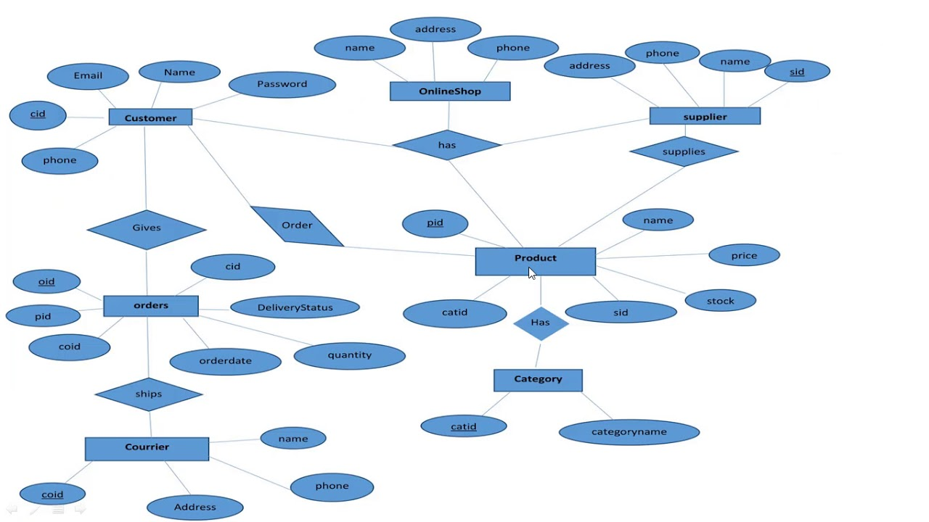
ER DIAGRAM OF ONLINE SHOP

Slide 9
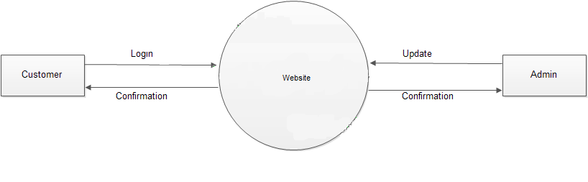
DATA FLOW DIAGRAM OF THE PROJECT
A data flow diagram is a primary graphic tool for the analysis phase of the system development life cycle. An information moves through software, it is modified by the series of transformations. The DFD serve two purpose:
To provide an indication of how data are transform as they move through the system.
To depict the functions that transform that data flow.
Level 0:

Slide 10
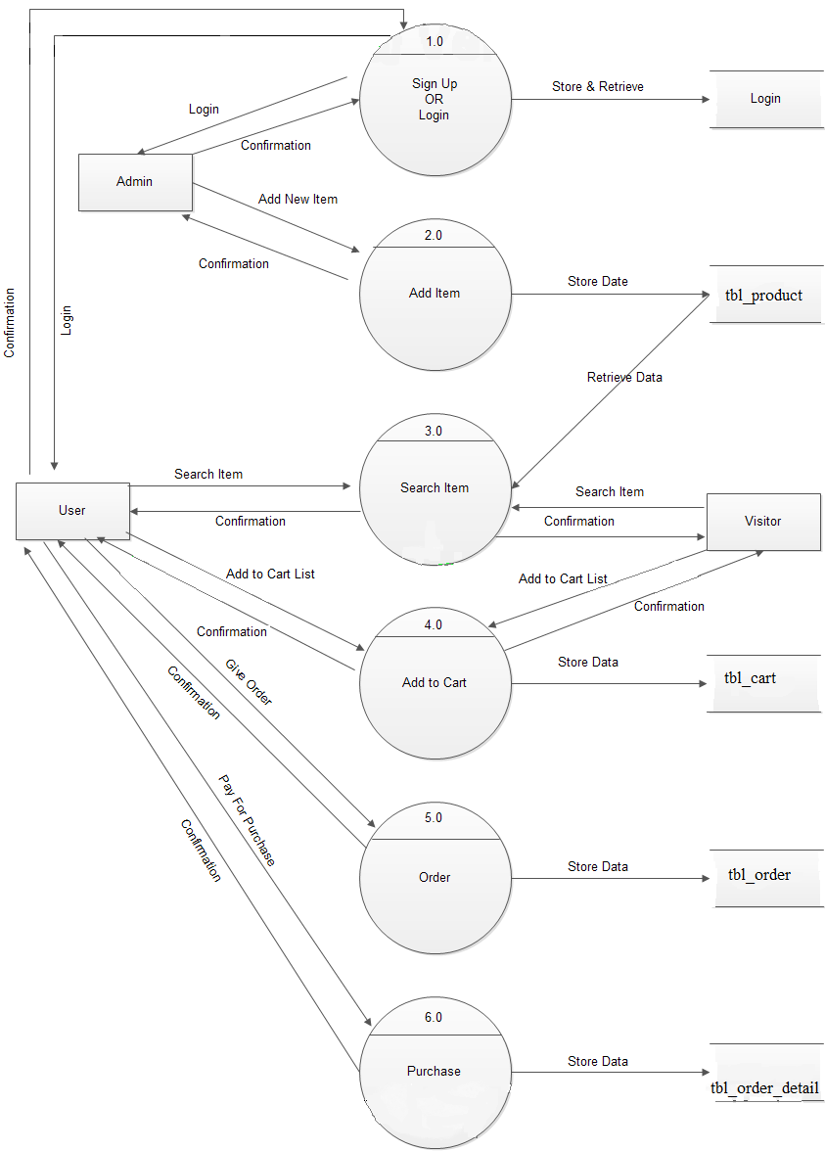
Level 1:

Slide 11
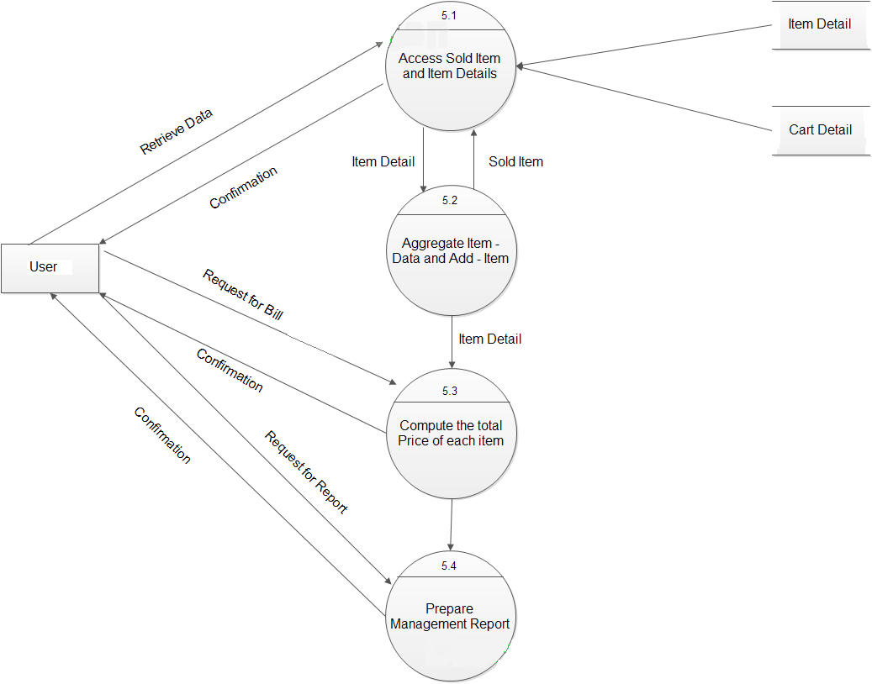
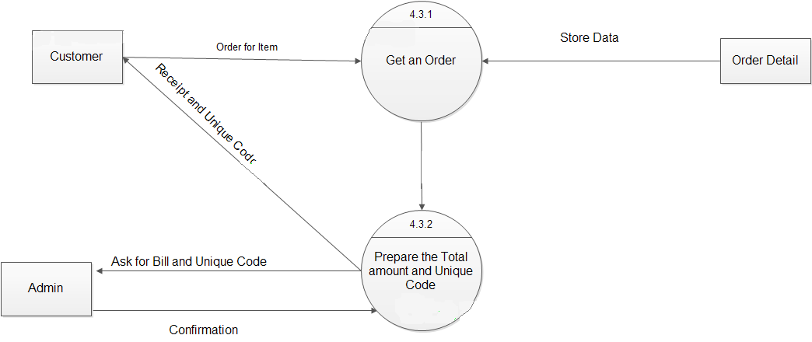
Level 2:
Level 3:

Slide 12
AVAILABLE PAGES IN THE SITE
Home: The Index page is the storefront of this site and welcome the customers into our site.
Category overview: Landing page for overall categories like men or women watch, smart watch, party watch etc.
Product Page: Show the information of the individual product with the main call to action “add to cart”.
Sign Up/create account: To create a account of the customer for buying the product. The account is also a great way to provide loyalty points management.
Login: If any customer want to buy product and he/she create account in the site then they need to login in that site.
Cart: The cart where customer selects what they want to purchase and total amount will appear.
Payment: Payment is that in which way the customer want to pay for the product.
My Order: Order history is shown in the account and it will help the customer to go back and reorder an item.

Slide 13
ADVANTAGES
In avoids the lot of manual work.
User can easily access the system without much experience.
Provide software and hardware securities.
User friendly screen to enter the data.
Portable and flexible for further extension.
It saves time and money.
No need for cash in hand.
24*7 available.

Slide 14
FUTURE SCOPE OF THE PROJECT
Online shopping is a web based project which is made for remote-shopping through internet. Now a days we can place the order for any thing from house. There is no need to go the shop. The payment, the confirmation of purchasing; we can do everything we want. Now we think that how the days have been changed with time. People had to stand in the rows for buying that particular things from the popular shop. But now a days we can extremely surprise that those things can be available on the door step in few hours.
In future we will try to make this website which work so flexible and beneficial for the customer and also try to make smooth service.

Slide 15
CONCLUSION
We have successfully implemented the site “Online shopping” with the help of various links and tools; we have been able to provide a site which is run by the local host. We have been successful in our attempt to take care of the needs of both the customers as well as the administrator. Finally we hope that this will go a long way in popularizing the organization and making its work of enrollment, keeping track of Artist’s Arts, problem solving, etc much more efficient.

Slide 16
THANK YOU

